Slide 1
Mudra - Your health is In your hand SESSION ON : MUDRA BY : DHARANI gm BCOM., MBA., MSC yoga certification in yogic science (bss) CERTIFIED YOGA TRAINER (YOGA ALLIANCE USA) CERTIFIED YOGA THERAPIST CERTIFIED MUDRA THERAPIST CERTIFIED DEITITIAN IN AYURVEDIC diet & NUTRITION

Slide 2
MUDRAS
It signifies a gesture, a mystic position of the hands, a seal, or even a symbol.
Though mudras are largely associated with hand gestures, there are eye positions, body postures, and breathing techniques also that are called mudras.
The word Mudra represents 'gesture' or 'attitude.‘
Mudras express psychic, emotional, devotional, and aesthetic gestures or attitudes.
Yogis have experienced mudras as a behaviour of energy flow, to link individual pranic force with universal or cosmic force."

Slide 3
THE HISTORY OF MUDRAS
Lord Shiva was said to be the first exponent of Mudras. According to tantric texts, he revealed this abundant knowledge to Devi Parvati. This signifies that knowledge is not easily accessible even to the Gods.
Only a clear and undisturbed mind can practice Mudra and attain its full benefits.
Those Practitioners who are disciplined, devoted, deserving can master it.
They have appeared in varying religions and traditions including Hinduism, Buddhism, Christianity

Slide 4
Benefits of Mudras
Mudras are an excellent alternative therapy.
● Mudras act naturally, are simple and gentle and works on regaining our health without any difficulties.
● There are no ultra-sophisticated instruments involved in using Mudra.
● Mudra being universal, they can be performed anywhere and anytime and by anybody.
● All kinds of illnesses, simple or serious, can be cured by Mudras.
● Mudras even help the semi-conscious or unconscious people.

Slide 5
HOW DOES MUDRA WORKS
Yoga mudras alter the flow of energy through your acupressure system.
When you change the position of your hands and fingers, you literally alter the prana in your body.
The manipulation of prana through Madras takes place in much the same way that energy in the form of light or sound waves is diverted by a mirror
Mudras activate the three nadis and ensure that the flow of prana takes place properly without waste.
Mudra enables the flow of energy effortlessly and freely from the base of your spine (the Root Chakra), throughout and beyond the top of the head (the Crown Chakra).

Slide 6
MUDRA AND SCIENCE
Mudra science is an ancient science that which connects certain energy-flows in mind body system.
Mudras work on the nerves, they are a NEURAL SCIENCE. When any mudra is performed, neural impulses are first generated within the brain itself.
Science also confirms that around every tip there is a concentration of free electrons. By touching together of the tips of the fingers or the finger tips to other parts of the palms this free energy (Prana) is redirected back into the body along specified channels, back up to the brain.
The redirected energy traveling through the nerves stimulates the various chakras. When you hold or press a particular finger in yoga mudra, the corresponding energy centre or gland stimulates in the brain (Power supplier of the circuit).
In this way, the brain receives a signal to alter the energy pattern within the body by regulating the Prana flow.

Slide 7
TYPES OF MUDRAS
Hasta (Hand) mudras:
Mana, head mudras: These practices form an essential part of the kundalini yoga. They utilise the eyes, ears, nose, tongue, and lips.
EXAMPLE :Shambhavi mudra ● Nasikagra drishti ● Khechari mudra
Kaya, postural mudras: These practices utilise physical postures combined with breathing and concentration.
Vipareeta karani mudra ● Yoga mudra
Bandha, lock mudras: : These practices combine mudras and bandhas. Maha mudra ● Maha bheda mudra ● Maha vedha mudra
Adhara, perineal mudras: These mudra techniques redirect the Prana from the lower centers to the brain. Ashwini mudra ● Vajroli sahajoli mudra

Slide 8
GUIDELINES FOR PRACTICING MUDRAS
Systematic approach
Time of Practice
Place
Clothing
Posture -Sitting on a chair, Sitting with legs crossed, Kneeling on your heels: vajrasana, Practicing while standing, Practicing while lying down
Finger contact
Breathing

Slide 9
MUDRA AND PANCHA MAHABHUTAS

Slide 10
MAHABHUTA (ELEMENTS) | SENSE ORGANS & CHARACTERISTICS | DIAGNOSTIC POINTS | ACTION | RELATED SYSTEM | PRONE TO DISORDERS RELATING TO-
Akasha (Ether element) | Ears - Apratighatata (Free Flow) | Free flow of body constituents in hollow cavities, Various sounds produced inside the body | Smoothness Hollowness Space Lightness | digestive systems, respiratory system, circulatory systems, Lymphatic system | Depression, Hernia, thyroid disorders, throat problems, speech disorders, epilepsy, madness, foolishness, ear diseases, etc
Vayu (Air element) | Skin- Chalatva (Mobility) | Conduction and transmission activities, Transportation Processes | Dryness, Lightness Clarity, Fatigues Promotes and monitors different activities | Neurological system Limbic System | nervous disorders, blood pressure problems, cough and cold, lung disorders, physical pains/deformities, depression, locomotors ataxia, etc.
Agni (Fire element) | Eyes - Ushnatva (Heat) | Digestion, Metabolism Transformation Heat Production | Burning sensation Sleep, hunger Digestion/ Metabolism Complexion, Glow and good Colour | Digestive system and endocrine system | coldness or fever, skin diseases, increased coldness or heat in the body, loss of vital energy, eye problems, acidity, diabetes, and mental disorders.
Jala (Water element) | Tongue-Dravatva (Liquidity) | Fluid balance Maintaining moisture and coldness | Dampness/ moisture Lubrication Compactness, Integrity Smoothness/ buffer Satisfaction | Excretory and reproductive system | Cold, sinusitis, asthma, swellings, blood thinning or blood clotting, the problem of urination, infertility, menstrual problems
Prithvi (Earth element) | Nose | Body Mass Body Odour | Nourishments to tissues Heaviness Hardness and compactness Stability | bones, bone marrow, ligaments, tendons, hairs, teeth, cartilages, fat | Bone related disorders ,weakness, obesity, cholesterol, skin problems, weight loss and weight gain,Weak and brittle bones & teeth

Slide 11
Mudras and Tridoshas

Slide 12
Mudras and Tridoshas
Vata dosha is the principle of mobility regulates all activity in the body, mental as well as physiological.
joint problems, dryness, stiffness, roughness, brittle teeth and bones and problems relating to nervous system, , Prone to constipation and chronic immune challenges. Weakness in the nervous& circulatory systems .
Trouble focusing or committing to anything when there is excess Vata in the body.
Mudras can relieve symptoms in the body or mind, particularly those involving the index and middle fingers.
Pitta dosha controls hunger, thirst, and body temperature.
When Pitta is excessive, you may get angry, high blood pressure, sweat too much, red skin and rashes and crave spicy food
Pitta imbalance : gallbladder, bile and liver disorders, acidity, stomach ulcers Prone to loose stools, heartburn. weakness in the liver & skin rashes.
Mudras involve the thumbs to treat pitta imbalances, such as how your Thumb presses the other fingers or palm.

Slide 13
Mudras and Tridoshas
Kapha dosha Kapha, provides the foundation for the other doshas.
is associated with stability and energy storage: it gives strength. It’s responsible for development of different types of tissue.
Kapha imbalance in the body can cause ailments like diabetes, depression, asthma excessive of sleep, lethargy, weight gain, allergies, fluid retention and congestion, nausea, lethargy, white coloration, looseness of joints, cough, dyspnoea and hypersomnia.
Mudras can be very helpful for Kapha imbalances, particularly those involving the ring and little fingers.

Slide 14
THE FIVE BASIC FINGER POSITIONS
1.Joining your thumb tip to a fingertip encourages stability in the linked element.
2. Touching the back of a finger (nail or knuckle) decreases the linked element’s influence.
3 Bringing your Thumb to the base of any finger stimulates the linked element.
4.When your palm faces upward, you open to receiving inspiration and energy.
5.When your palm faces downward, you become more grounded

Slide 15
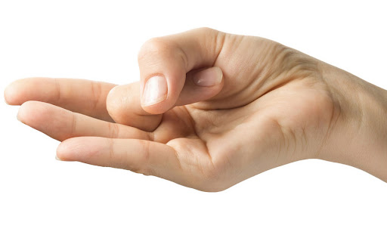
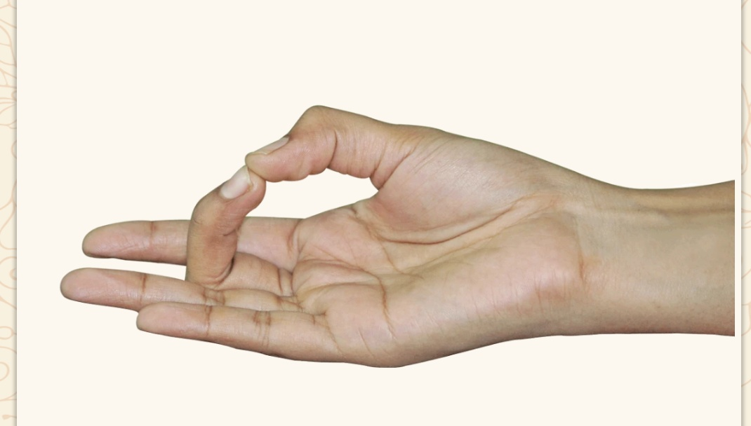
VATTA DHOSHA BALANCING MUDRAS MUDRAS for VATTA DEFICIENCY Mudra for Vata Dosha Excess CHIN MUDRA AKASHA MUDRA shunya mudra
CHIN MUDRA - stabilize our mental thoughts by reducing dullness of memory, drowsiness, and lethargy
AKASHA MUDRA - Relive the Condition of Migraine, Reduces Sinusitis Pain Improve Hearing Loss Overcome Calcium Deficiency, activates Throat Chakra
SHUNYA MUDRA: relieve ear pains, vertigo issues by reducing the space element, treats hypo thyroid and Ailments related to the heart will also decrease.

Slide 16
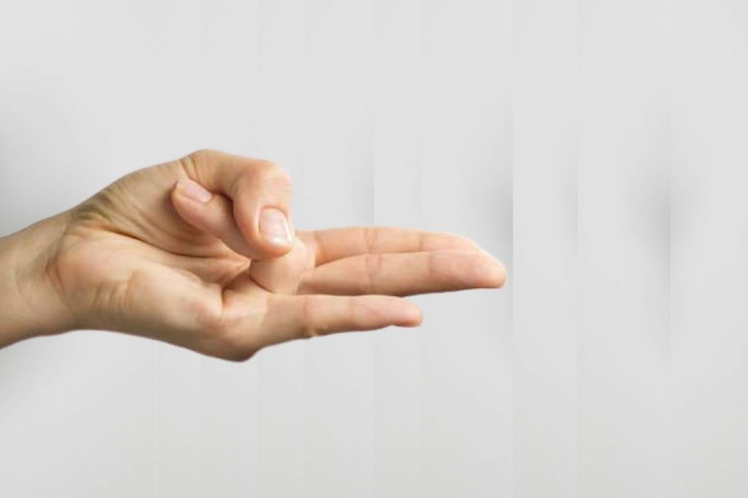
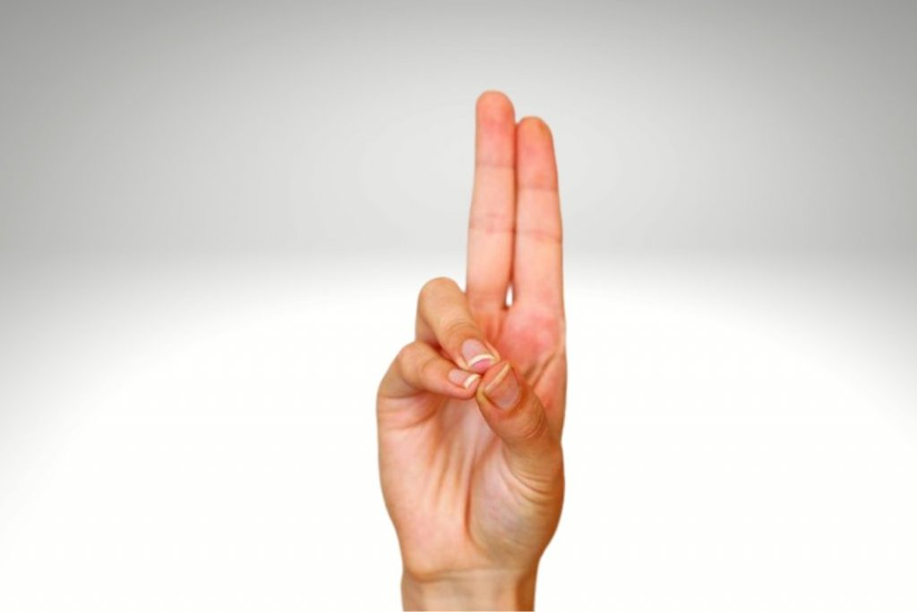
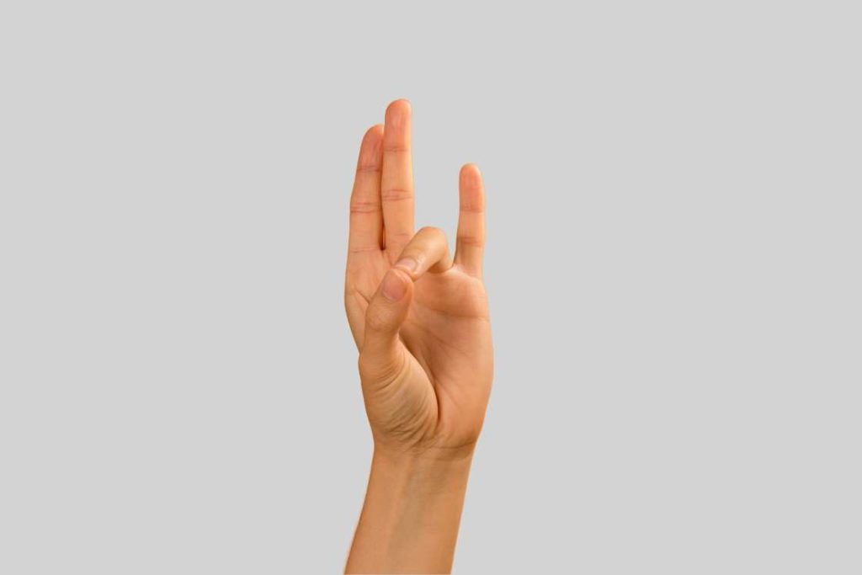
pitta DHOSHA BALANCING MUDRAS
Mudra for Pitta Dosha deficiency Mudra for pitta Dosha Excess Surya mudra. Prana Mudra PRITHVI MUDRA
SURYA MUDRA : as the name depicts, this mudra is related to increasing the fire element and decreases the earth element in the body, regularizes the metabolism. It improves appetite and digestion. it is one of the most recommended mudras for balancing the pitta & Kapha dosha. cures indigestion and sleep-related issues, helps in detoxification of the body, aids in weight loss, stimulates the digestive system, cures thyroid issues. With an increased body temperature, you will also not contract cough and cold frequently. Feelings of coldness, indigestion, cholesterol, swelling are all cured by this mudra.
PRANA MUDRA: helps to treat any burning sensation or heat-related, treats foul odour due to excess sweat. Enables sufficient sleep there by tension, anger, fatigue, forgetfulness, irritability, and other related feelings will get washed away. problems related to digestive and metabolic activities will also be cured.
PRITHVI MUDRA: ulcers, gas problems, inflammation, or fever can be cured by this mudra. It also aids in the healthy glow of the skin. you will feel energetic and your stamina and endurance will also be enhanced. Helps in weight gain.

Slide 17
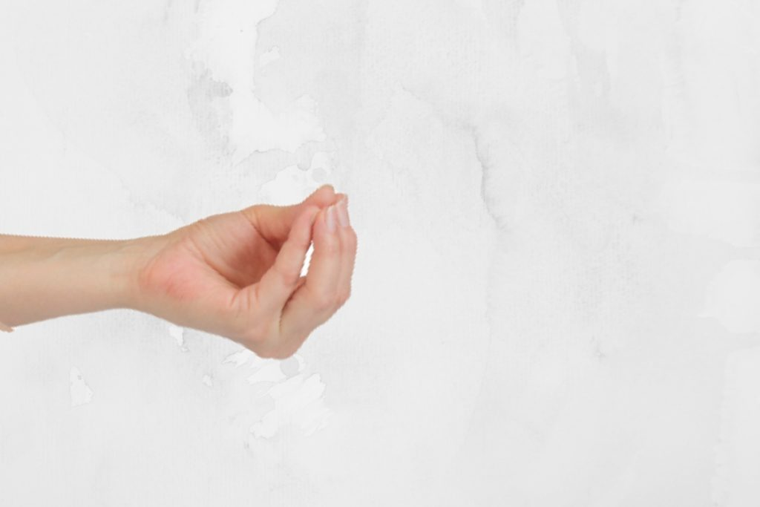
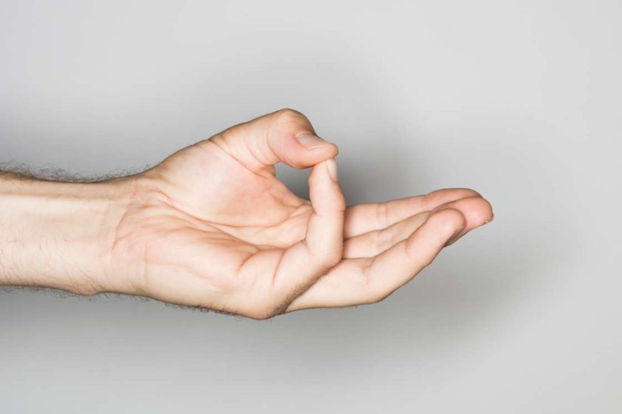
kapha DHOSHA BALANCING MUDRAS
Mudra for KAPHA Dosha deficiency Mudra for KAPHA Dosha Excess
SAMANA MUDRA VARUNA MUDRA SURYA MUDRA
SAMANA MUDRA : This mudra is known to balance the energies of the three doshas or tri-doshas with its healing abilities. It will strengthen your body from the inside out hence this mudra can also be performed in conjunction with the other mudras.
VARUNA MUDRA : the water element in your body will increase, This mudra is best for issues of itchiness on skin or eyes. It helps in reducing cholesterol and promotes glowing skin. Feelings of internal burning will also reduce as it decreases the fire element in the body. If you have a fever, this mudra is beneficial as the increased water element will help in cooling down your temperature.

Slide 18
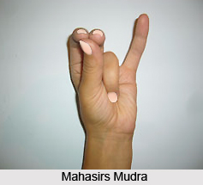
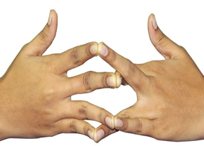
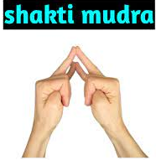
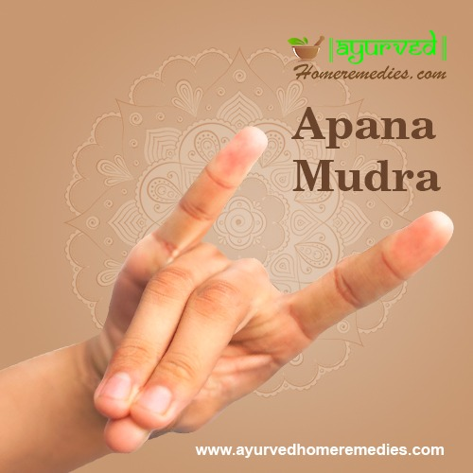
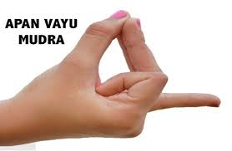
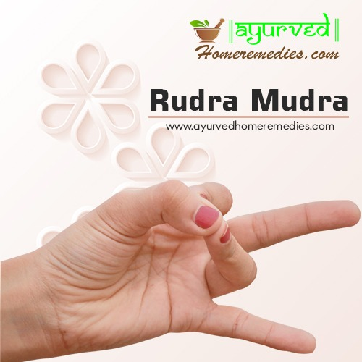
MUDRAS FOR COMMON AILMENTS BACK PAIN HEADACHE THYROID women health INSOMNIA CONCENTRATION STRESS & ANXIETY diabetes high bp low bp

Slide 19
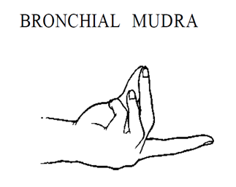
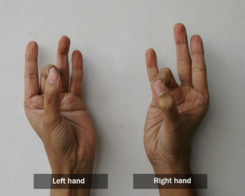
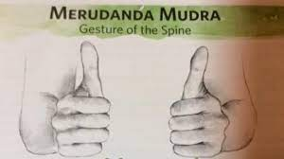
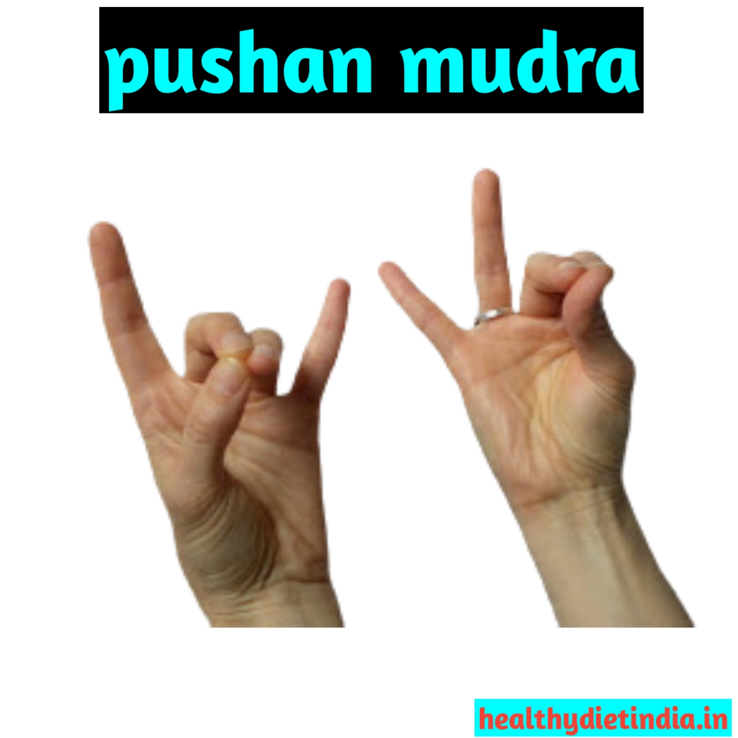
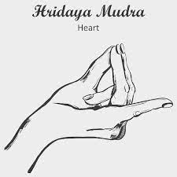
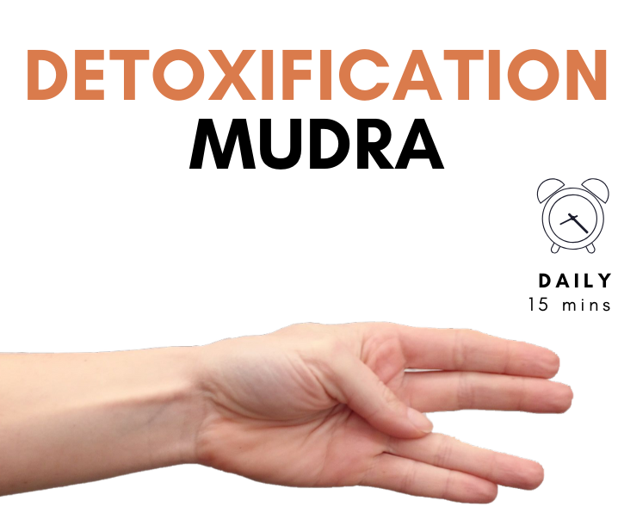
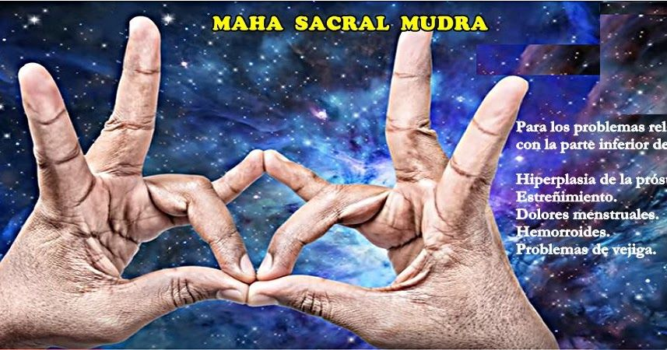
MUDRAS FOR COMMON AILMENTS lung diseases joint mudra spine health digestive disorders heart health body detox menstrual cramps obesity excess water disorders

Slide 20
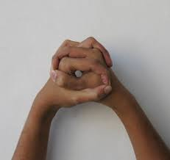
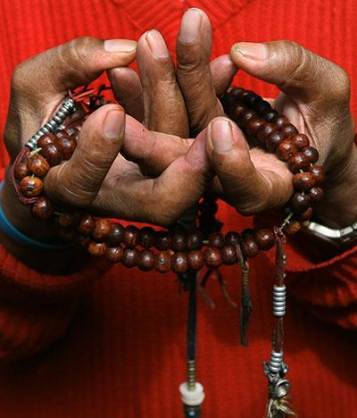
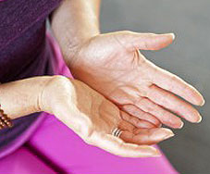
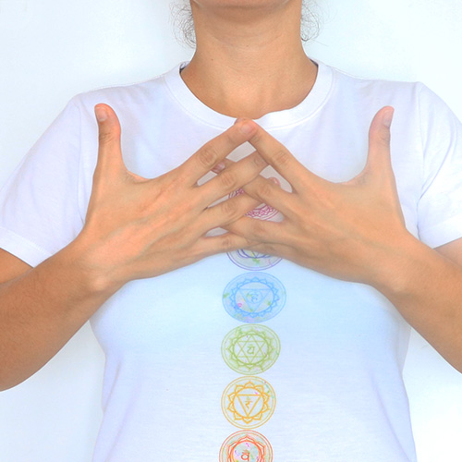
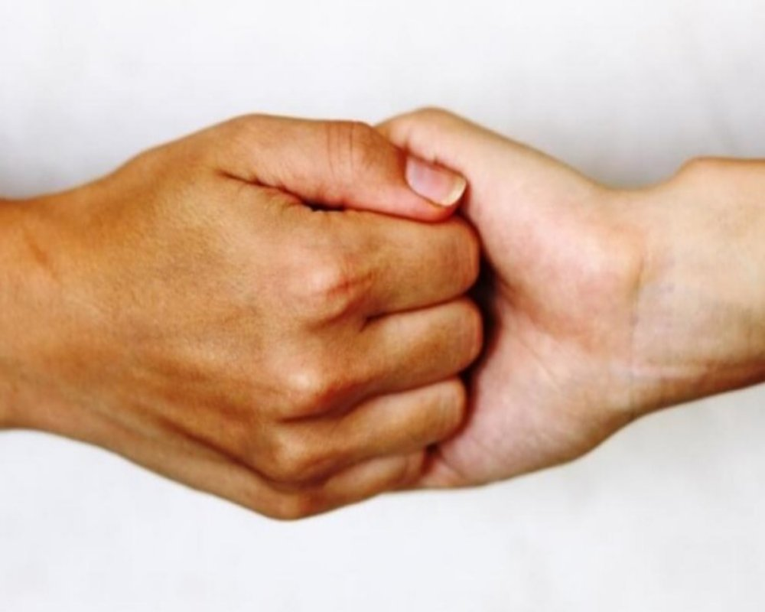
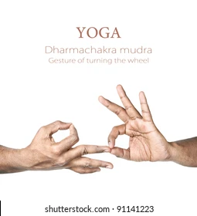
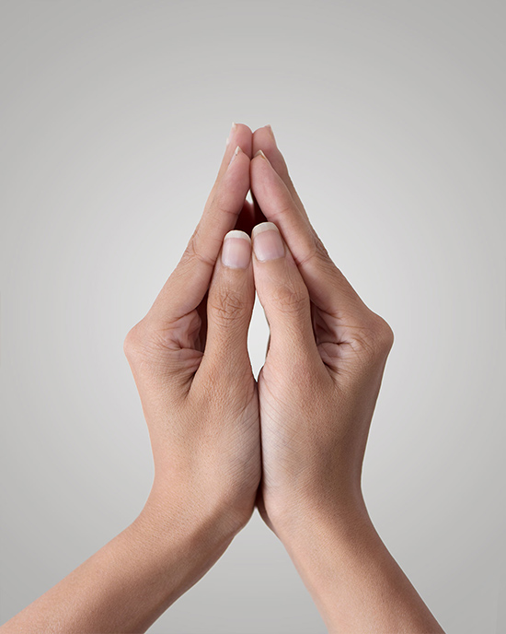
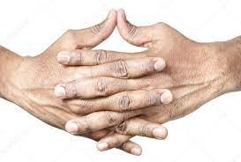
Mudras for prayer Anjali mudra granthita mudra mandala mudra pushpaputa mudra naga mudra Vajrapradama ganesha mudra dharmachakra mudra of inner self ushas mudra Mudra mudra

Slide 21
Benefits of prayer mudras
Anjali mudra improves focus during meditation. It promotes mindfulness and inner awareness. It relieves the stress & calms the mind. It connects the brain’s right and left hemispheres.
granthita mudra Knot Mudra or Granitha mudra opens the knot in the throat center. It activates the Vishuddhi Chakra (throat chakra), opens the vocal cord passage, thereby making speech clear and sweet, and also balances the Thyroid gland and induces self healing. It is beneficial for cancer patients
Mandala mudra is a complex hasta mudra (hand gesture) used primarily in conjunction with Buddhist prayers and chants to balance the mind and emotions. Helps to reduce one’s attachment and purify the dissolving mind. Helps you to centre yourself and helps you to connect with the universe at large. It helps to increase your need for meditation.
pushpaputa mudra means a "handful of flowers" this Mudra is said to heighten our sense of compassion towards others, help us overcome fear, relieve negative emotions and promote inner spaciousness.
NAGA MUDRA This hand gesture is used to overcome obstacles in life and also it develops clarity. It helps to relieve anxiety and stress. With the regular practice of this Mudra, it is possible to face spiritual growth and challenges.

Slide 22
Benefits of prayer mudras
Vajrapradama Mudra provides you the feeling of self-assurance and builds your confidence and positivity. It helps you in tackling insecurities. It builds a balancing power to improve mental, physical, and emotional stability. It helps in controlling our breaths.
Ganesha mudra opens the Anahata Chakra or the heart chakra due to which the person feels the symptoms of love, empathy, courage, confidence and openness. It strengthens the weak hearts. It activates fluid circulation in the body. It includes all the five elements of your body (air, fire, earth, and water, or metal). It energizes the body and boosts self-esteem and self-confidence. It is considered good for overall health of the immune system.
dharmachakra MUDRA Dharmachakra in Sanskrit literally means the “Wheel of Dharma”. This mudra symbolizes one of the important moments in the life of Buddha, the occasion when he teaches to his companions the first sermon after his Enlightenment Dharmachakra mudra recovers meditation power. This mudra makes sure there is an everlasting change inside the person.
mudra of inner self Mudra of the Inner Self shines a light on the soul within. It is specially designed to deepen the levels of meditation, consequently helping in the spiritual journey. It is an additional expression of devotion.
ushas mudra It balances or synchronizes the left and right hemispheres of the brain. Thus, helps in bringing clarity to the mind and promotes awareness. It regulates the endocrine system there by regulates the proper hormonal flow and provides benefits in long run. This Mudra Regulates irregular menses . It Stimulates Sacral chakra and enhances social life, sexuality, creativity, and brings pleasure. This Mudra also Uplifts energy level .

